Slide 1
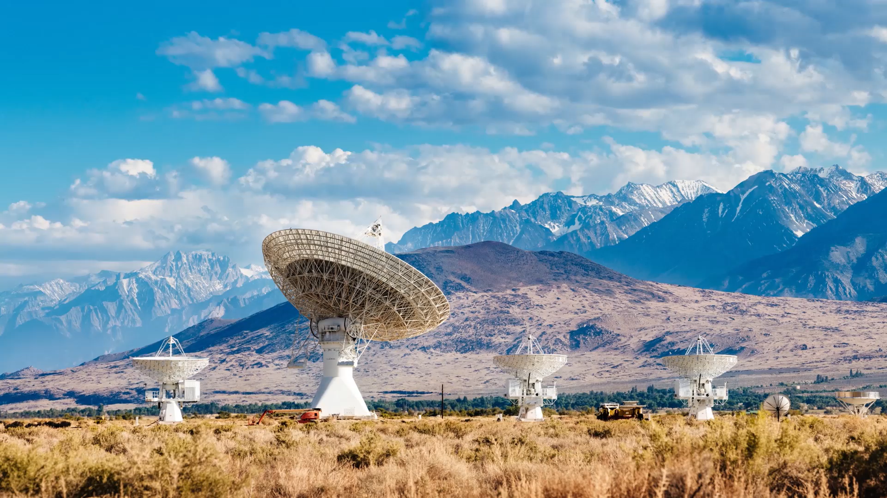
Ad Campaign Optimization
ML Assignment - Progress Report
Presented by: Saad (24WU0202359)
Course: Business Analytics| Date: 24/04/2025

Slide 2

Problem Statement
How can we dynamically allocate budget across different ad platforms and creatives to maximize return on ad spend (ROAS)?

Slide 3
About the Problem Statement
Dynamically allocating budget across ad platforms and creatives to maximize return on ad spend (ROAS) involves constantly adjusting where and how money is spent based on performance data. Different platforms—such as Google, Meta, and TikTok—have unique strengths and audience behaviors, meaning the same budget or creative might perform very differently on each. The challenge lies in finding the right balance: identifying which platform and which creative asset are delivering the best results at any given time.
To tackle this, marketers use data-driven attribution models and real-time performance tracking. By collecting performance metrics like ROAS, cost-per-acquisition (CPA), and engagement rates, brands can build optimization systems that automatically reallocate budgets toward high-performing channels and creatives. Technologies like machine learning, multi-armed bandits, or rules-based algorithms can help predict outcomes and recommend where to shift spend dynamically.
Ultimately, the goal is to create a continuous feedback loop that monitors performance, tests new creatives, and reallocates budget frequently to maximize returns. Tools like Google Performance Max or Meta Advantage+, combined with custom analytics dashboards or AI-powered optimization platforms, make it possible to automate much of this process. The result is a smarter, more agile ad strategy that adjusts in real time to changing consumer behavior and market conditions.

Slide 4
Why I Chose This Problem
I chose this problem statement because in today’s digital marketing landscape, brands are active across multiple ad platforms, and each platform’s performance can vary dramatically. Budget allocation decisions are often made manually or based on outdated performance snapshots, which leads to inefficiencies and missed opportunities. By focusing on dynamic budget allocation, I aim to solve a real-world issue that can significantly impact marketing effectiveness and business growth.
This problem is also compelling because it sits at the intersection of marketing strategy, data science, and technology. Solving it requires integrating data analytics, automation, and machine learning—skills that are in high demand and personally exciting to work on. It’s a great opportunity to build a system that not only learns from past performance but also makes smart, forward-looking decisions in real time.
Lastly, I chose this challenge because it has the potential for measurable, high-impact outcomes. Improving ROAS directly affects profitability and scale. Businesses can stretch their ad dollars further, gain better insights into customer behavior, and adapt quickly in fast-changing markets. This makes the problem both practically valuable and strategically significant.

Slide 5
Literature Review
The application of machine learning to marketing budget optimization has seen increasing attention from researchers and practitioners. Various models—from regression-based techniques to reinforcement learning—have been proposed to allocate advertising budgets in a way that maximizes campaign performance.
Several studies have examined multi-touch attribution, media mix modeling, and reinforcement learning for dynamic ad spend optimization. These techniques attempt to estimate the marginal ROAS of spending an additional dollar on each platform or creative. The integration of ML in budget allocation not only automates decision-making but also ensures higher responsiveness to performance trends.

Slide 6
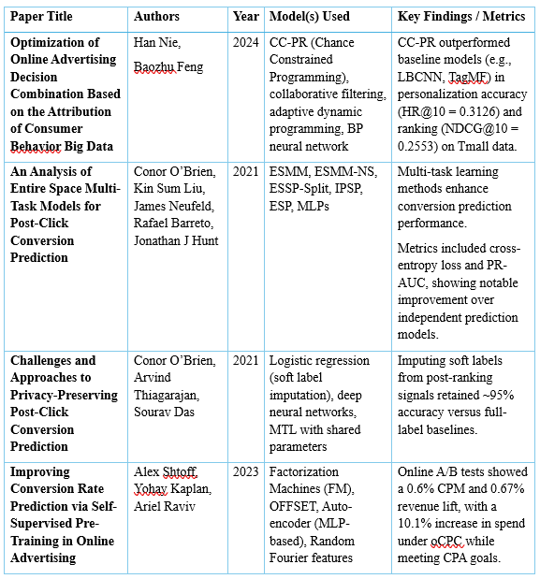

Slide 7
Research Methodology
This study employs a structured, multi‐phase approach to optimize Return on Ad Spend (ROAS) through dynamic budget allocation using machine learning. After defining objectives—maximizing average ROAS, minimizing wasted spend, and adhering to platform constraints—a comprehensive dataset was assembled via API calls and CSV exports from Google Ads and Facebook Ads Manager, encompassing impressions, clicks, conversions, cost, ROAS, device types, campaign objectives, and creative attributes over multiple months. Data preprocessing included mean/median imputation for missing values, One‑Hot and Target Encoding for categorical features, and normalization with StandardScaler and MinMaxScaler. Feature engineering produced Cost Per Conversion, CTR, Conversion Rate, lagged ROAS, rolling averages, and seasonality indicators, with importance metrics guiding variable selection. For modeling, we implemented and tuned Gradient Boosting (XGBoost, LightGBM), Random Forest, Linear/Ridge Regression baselines, and reinforcement learning agents (Q‑Learning, DQN) using GridSearchCV and Bayesian Optimization. Predictive models were evaluated via RMSE and R², while RL agents were assessed on cumulative ROAS improvements in a simulated environment designed to mirror real‐world constraints and generate daily budget recommendations. Finally, the complete pipeline was containerized in Docker, exposed through a Flask API, and visualized via a Streamlit dashboard, with deployment on Google Cloud Platform and AWS EC2 to support scalable, real‐time inference.

Slide 8
Dataset from Kaggle
Dataset:
KAG_conversion_data
Features:
ad_id, xyz_campaign_id, fb_campaign_id, Impressions
Target Variable: Approved_Conversion (Number of conversions that were approved)
Source:
Kaggle
Link: https://www.kaggle.com/code/mansimeena/facebook-ad-campaigns-analysis-sales-prediction/input

Slide 9
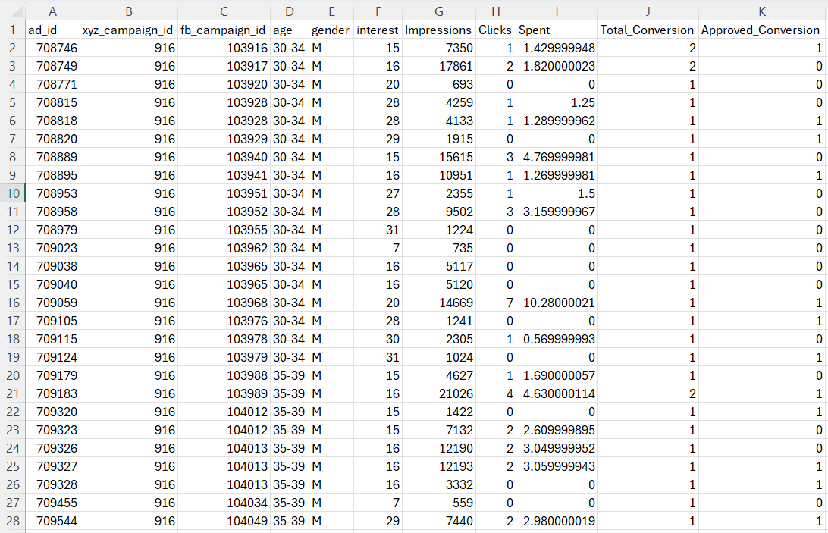
Dataset Preview

Slide 10
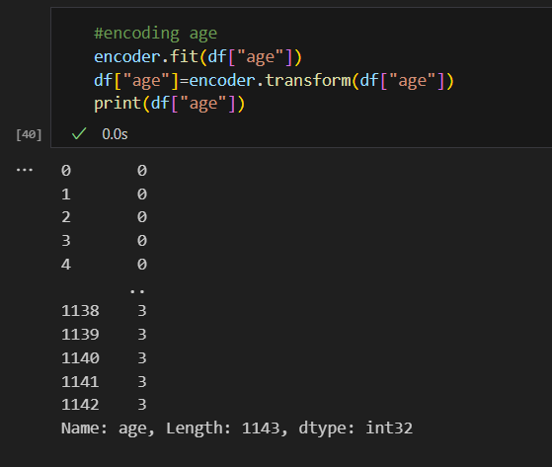
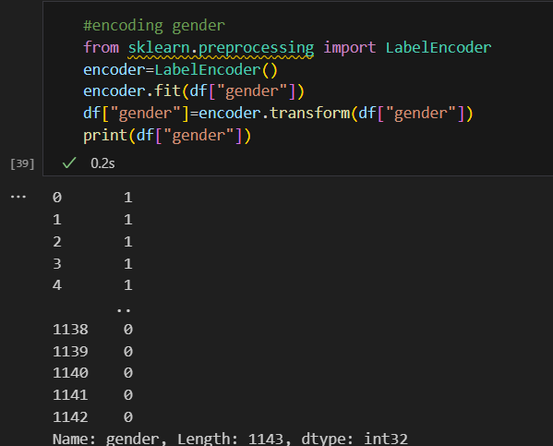
ML Model - Work Done So Far
Preprocessing: Missing values, Encoding, Scaling

Slide 11
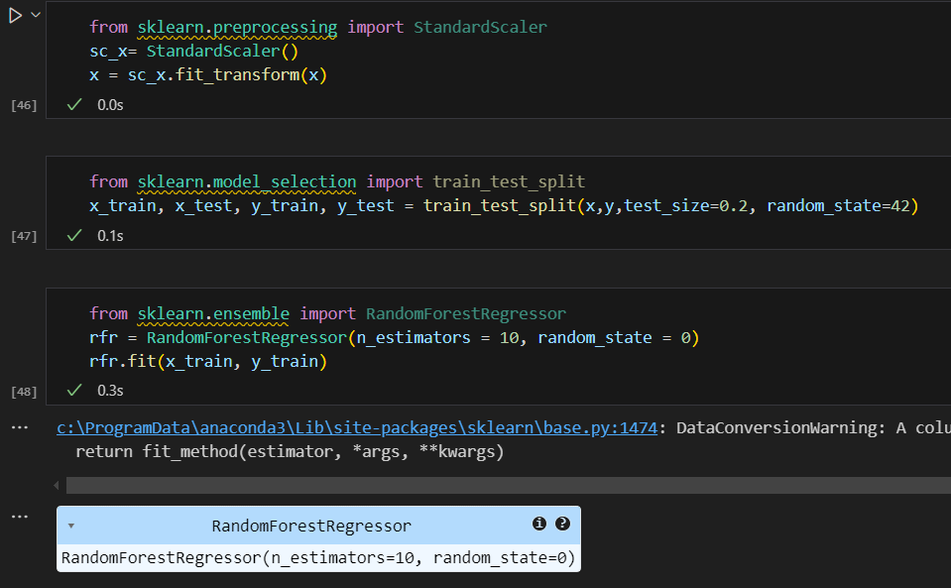
ML Model - Work Done So Far
Algorithms: Random Forest

Slide 12
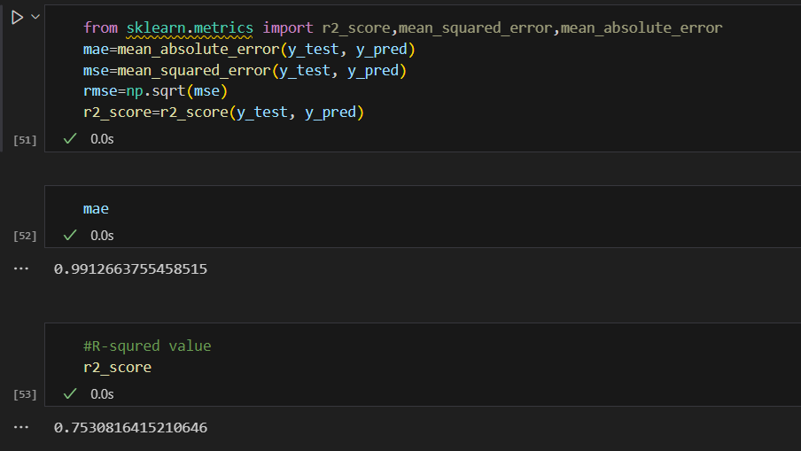
ML Model - Work Done So Far
Evaluation: Accuracy (Random Forest)

Slide 13
Frontend Plans
• Tools: HTML, CSS, Streamlit
• Features: User Input Form, Real-time Prediction
• Output: Approval Status with Probability

Slide 14
Roadmap Ahead
• Finalize best ML model
• Build frontend UI
• Add model explainability
• Deploy with Streamlit / Flask
• Final report and demo

